Slide 1
Gestalt Principles of Visual Perception

Slide 2
Gestalt Principles of Visual Perception
Gestalt – Movement in experimental psychology which began prior to WWI.
We perceive objects as well-organized patterns rather than separate components.
“The whole is greater than the sum of it’s parts.”
Based on the concept of “grouping”.

Slide 3
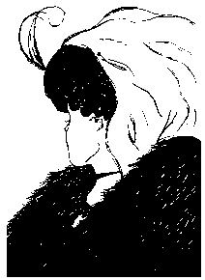
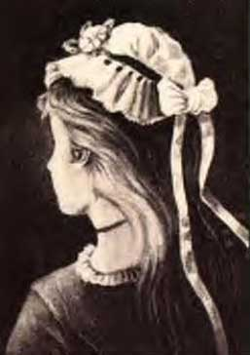
Gestalt Principles of Visual Perception
W.E. Hill, 1915
German postcard, 1880
We impose visual organization on stimuli

Slide 4
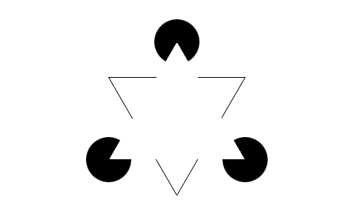
Gestalt Principles of Visual Perception
Illusory
Contours
The Kanisza triangle as figure-ground illusory contours

Slide 5
Gestalt Principles of Visual Perception
Three Main Principles:
Grouping (proximity, similarity, continuity, closure)
Goodness of figures
Figure/ground relationships

Slide 6
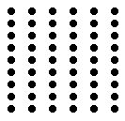
Gestalt Principles of Visual Perception
Grouping:
Law of Proximity

Slide 7

Gestalt Principles of Visual Perception
Grouping:
Law of Similarity

Slide 8
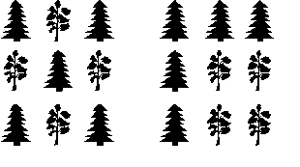
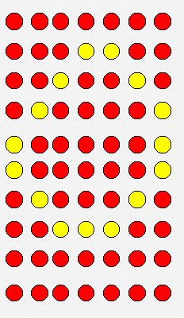
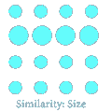
Gestalt Principles of Visual Perception
Grouping: Law of Similarity: Shape, Scale, Color

Slide 9
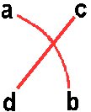
Gestalt Principles of Visual Perception
Law of Good Continuation, or Continuity
Objects arranged in either a straight line or a smooth curve tend to be seen as a unit.

Slide 10
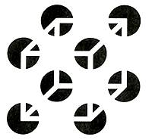
Gestalt Principles of Visual Perception
Law of Closure

Slide 11

Gestalt Principles of Visual Perception
Law of Common Fate

Slide 12

Gestalt Principles of Visual Perception
Goodness of Figure, or the Law of Pragnanz

Slide 13
Gestalt Principles of Visual Perception
Figure/Ground relationships
Figure – seen as the foreground
Ground – seen as the background
Contours – “belong” to the figure

Slide 14

Gestalt Principles of Visual Perception
Reversible Figure/Ground
relationship

Slide 15
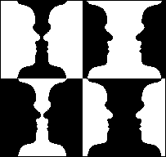
Gestalt Principles of Visual Perception
Reversible Figure/Ground
relationship
Can be affected by the principle of smallness:
Smaller areas tend to be seen as figures against a larger background.

Slide 16
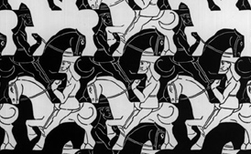
Gestalt Principles of Visual Perception
Reversible Figure/Ground
Relationship:
Tessellation – interlocking figure/ground
M.C. Escher

Slide 17
Figure-ground
When an object is surrounded by white space, keep a sense of proportion between the object (the figure) and its surroundings (ground).
The “figure” is the focal image
The “ground” is the background image

Slide 18
This page has lots of text and not much visual variation. As a result, readers won’t be drawn to any particular place on the page. This page has lots of text and not much visual variation. As a result, readers won’t be drawn to any particular place on the page. This page has lots of text and not much visual variation. As a result, readers won’t be drawn to any particular place on the page. This page has lots of text and not much visual variation. As a result, readers won’t be drawn to any particular place on the page. This page has lots of text and not much visual variation. As a result, readers won’t be drawn to any particular place on the page.

Slide 19
Is This Any Better?
This page has lots of text and not much visual variation. As a result, readers won’t be drawn to any particular place on the page. This page has lots of text and not much visual variation. As a result, readers won’t be drawn to any particular place on the page. This page has lots of text and not much visual variation.
As a result, readers won’t be drawn to any particular place on the page. This page has lots of text and not much visual variation. As a result, readers won’t be drawn to any particular place on the page. This page has lots of text and not much visual variation. As a result, readers won’t be drawn to any particular place on the page.

Slide 20
How about This?
This page has lots of text and not much visual variation. As a result, readers won’t be drawn to any particular place on the page.
    This page has lots of text and not much visual variation. As a result, readers won’t be drawn to any particular place on the page. This page has lots of text and not much visual variation.
    As a result, readers won’t be drawn to any particular place on the page. This page has lots of text and not much visual variation. As a result, readers won’t be drawn to any particular place on the page.
This page has lots of text and not much visual variation. As a result, readers won’t be drawn to any particular place on the page.

Slide 21
Figure-ground Contrast
Figure-ground contrast gives you a powerful tool to respond to any given rhetorical situation.
Be careful of “visual noise”
Noise is anything that interferes with the writer’s message
  Static on a phone line
  Busy backgrounds
  “Loopy” fonts

Slide 22
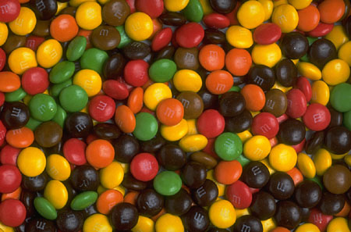
Figure-ground Contrast
Figure-ground contrast gives you a powerful tool to respond to any given rhetorical situation.
Be careful of “visual noise”
Noise is anything that interferes with the writers message
  Static on a phone line
  Busy backgrounds
  “Loopy” fonts

Slide 23
Noise
This is a noisy typeface.
Another noisy typeface
Still another. Can you IMAGINE this in ALL CAPS?
IMAGINE
IMAGINE

Slide 24
Grouping
Shows structure and organization
Threads parts into manageable units
Grouping creates “visual cohesion” that holds the parts together

Slide 25
Gestalt Principles of Visual Perception
Gestalt laws of Grouping organize the visual scene into units
The Law of Pragnanz, or Goodness of Figure creates the simplest most meaningful pattern
Figure/Ground relationships define important parts of the scene

